Slide 1
Water System Overview
August 2023

Slide 2
Topics Being Discussed:
General water system overview; City of Fulshear water plants:
Richard Weatherly, PE
FNI
Water System Summaries/
Summer demand
Mark Yentzen
Inframark
John Gilroy, PE
Baird Gilroy & Dixon, LLC
Planned Improvements
Richard Weatherly, PE
FNI
Water Incident; Monday, August 21
Mark Yentzen
Inframark
Aaron Coronis, CenterPoint

Slide 3
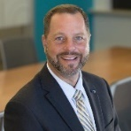
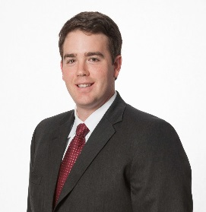
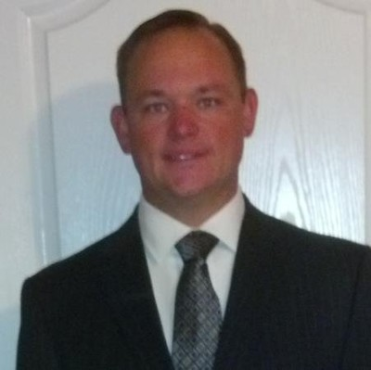
Introducing the Speakers
Richard Weatherly
Vice President, Freese and Nichols
Mark Yentzen
Vice President of
Client Services
John Gilroy
Co-founder & Principal of Baird Gilroy & Dixon, LLC
Aaron Coronis
Service Delivery Manager
CenterPoint
20 years of experience in the design of water and wastewater facilities.
20 years of water and wastewater treatment experience
15 years of experience in the design of water and wastewater facilities.
20+ years of experience with CenterPoint

Slide 4
Water System Vocabulary:
Connection: A single-family residential unit or each commercial or industrial establishment to which drinking water is supplied” from the Public Water System (PWS). (30 TAC § 290.38(16))
Water Capacity: Well capacity is the amount of water in gpm that the well produces without drawing down or water level dropping.
Water Demand: The quantity of water that the treatment plant must produce in order to meet all water needs in the community. Water demand includes water delivered to the system to meet the needs of consumers, water supply for fire fighting and system flushing, and water required to properly operate the treatment facilities.
Water demand varies seasonally with the lowest usage in winter months and the highest usage during summer months. Variations in demand also occur with respect to time of day. Diurnal peaks typically occur during the morning and early evening periods, while the lowest usage occurs during nighttime hours.
Climatic factors, such as drought, water management practices, and over-use/demand cause quicker draw downs upon water supplies.
Water Pressure: Measured in PSI (pounds per square inch) and represents the force at which water enters your home from the water main.
The system must maintain a minimum pressure of at least 35 PSI throughout the distribution system during normal operations, and a minimum of 20 PSI during emergencies, as specified in 30 TAC 290.46(r).

Slide 5
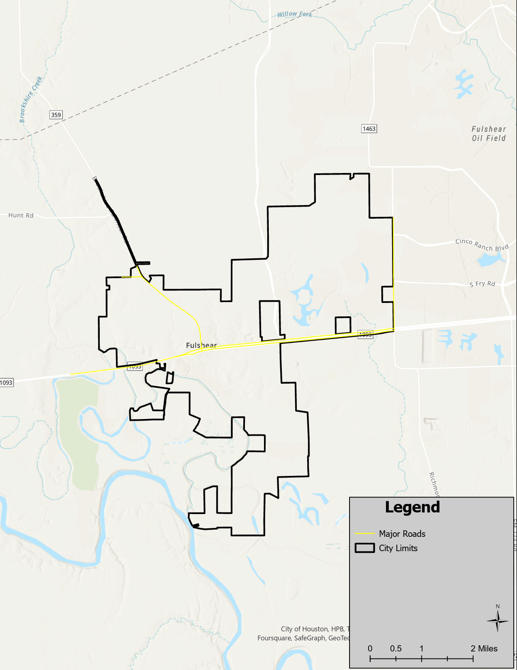
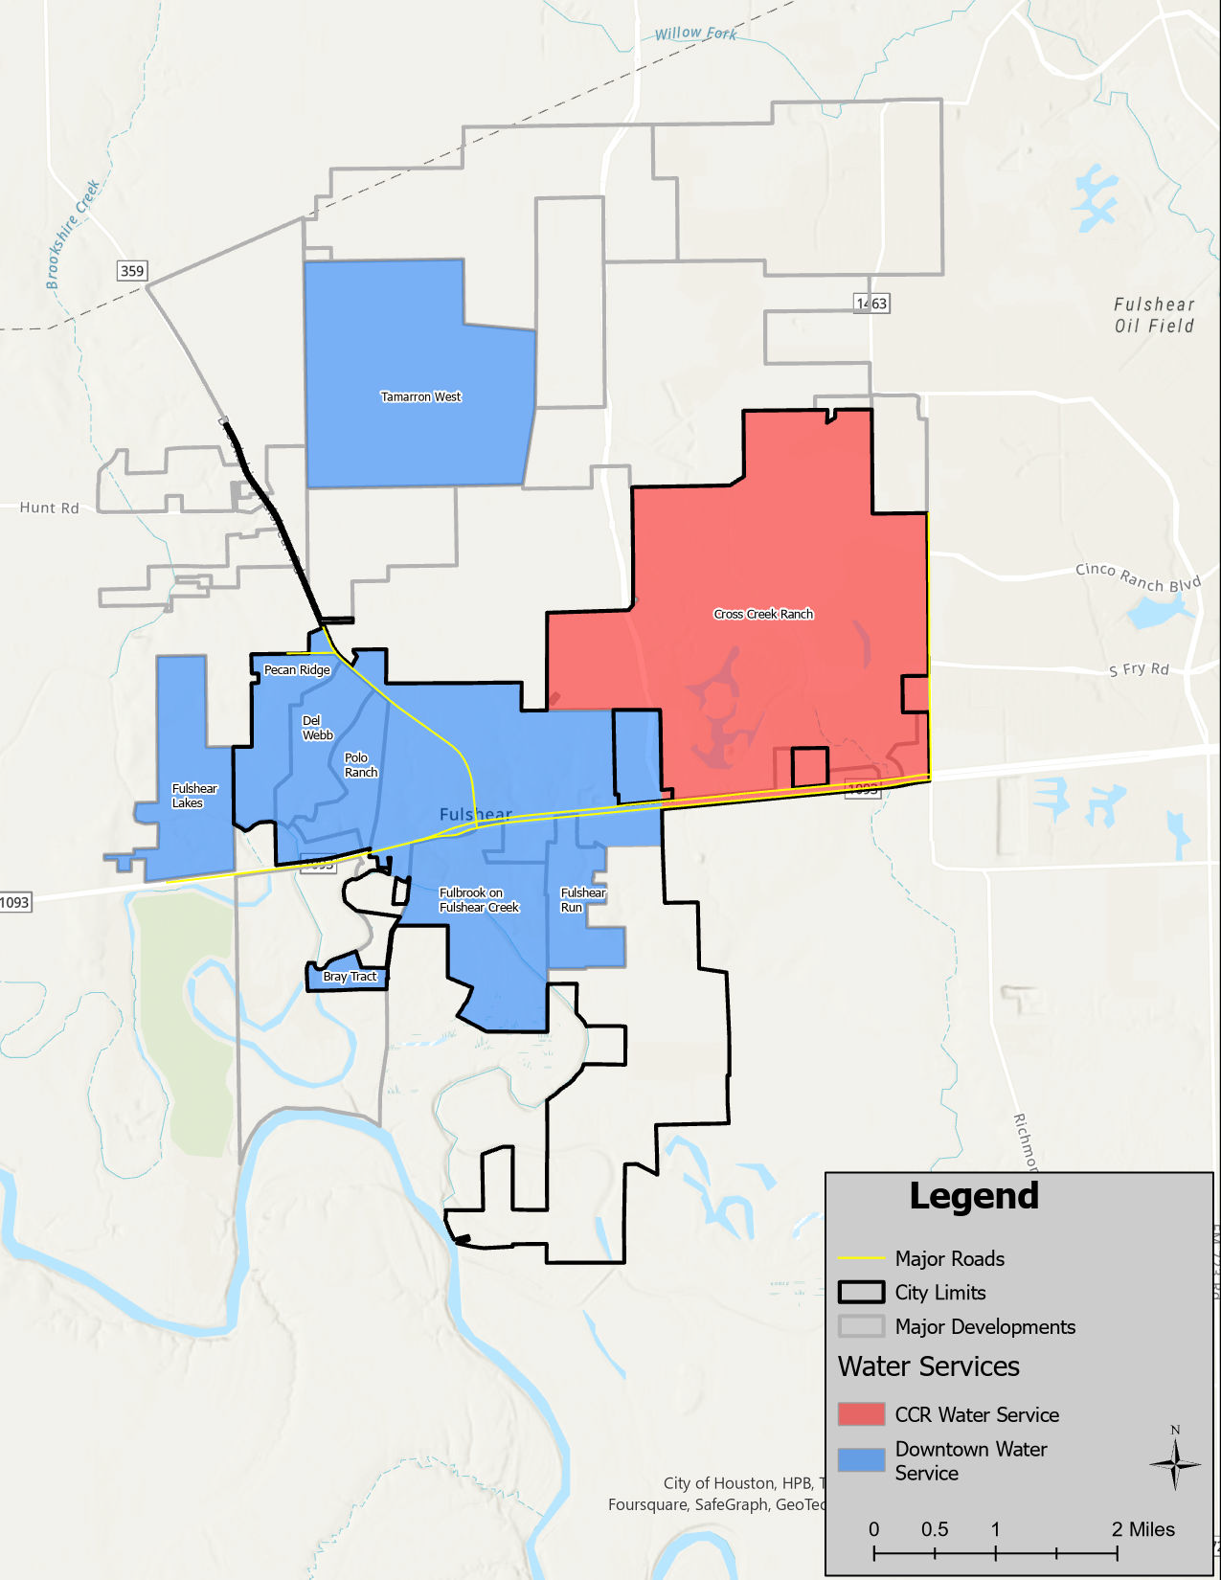
Water System Service Areas
City Limits
Water Service Areas
Downtown vs CCR
Water Service Areas

Slide 6
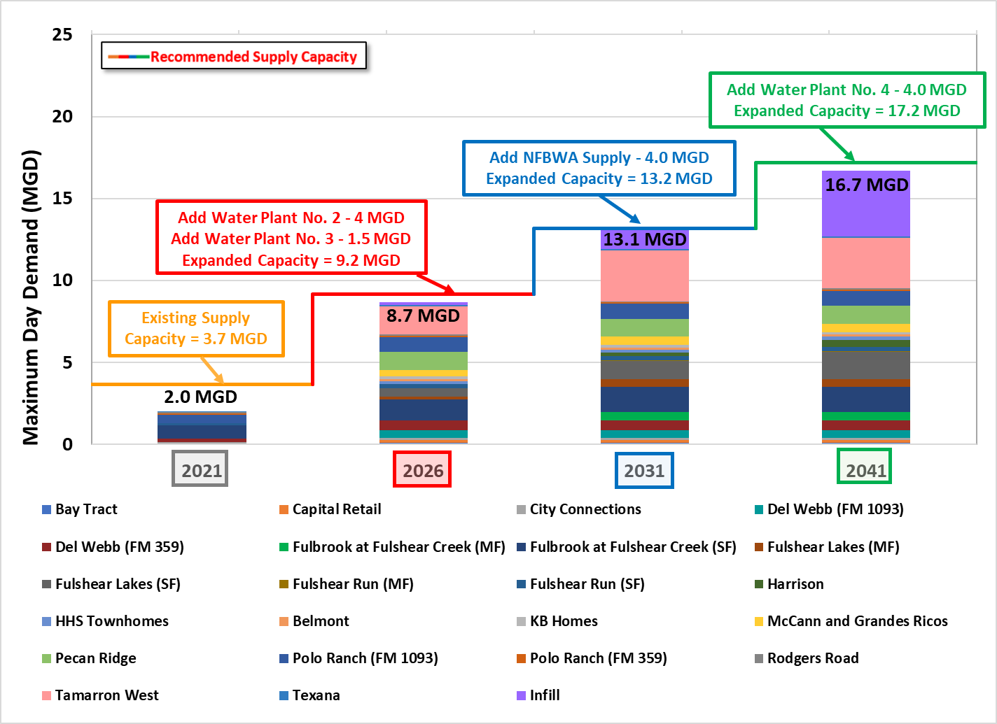
Downtown Water System Capacity
* Projections from City’s 2021 Water Master Plan

Slide 7
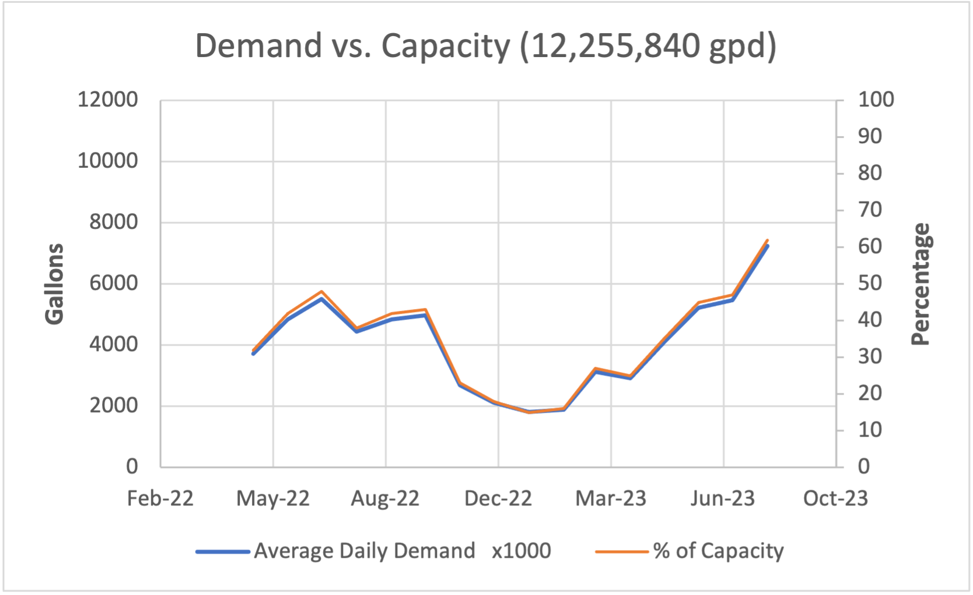
Water System Demand vs Capacity:
May 2022 – August 2023
Oct – May = 15 – 43%; Avg. = 25% of Capacity
June – August = 45-62%; Avg. = 51% of Capacity

Slide 8
Downtown Water System
Connections: 2,452

Slide 9
Downtown Water System
3 Wells – 3,664,800 GPD (Total Capacity per day)
Well 1 – 95 GPM – 136,800 GPD
Well 2 – 250 GPM – 360,000 GPD
Well 3 – 2,200 GPM – 3,168,000 GPD

Slide 10
CCR Water System
Connections: 5,988

Slide 11
Cross Creek Ranch Water System
4 wells: 8,591,040 GPD
WP #1 – 3,600,000 GPD
Well 1 – 1500 GPM – 2,160,000 GPD
Well 2 – 1000 GPM – 1,440,000 GPD
WP # 2
Well 3 – 1650 GPM – 2,376,000 GPD
WP #3:
Well 4 – 1816 GPM – 2,615,040 GPM

Slide 12
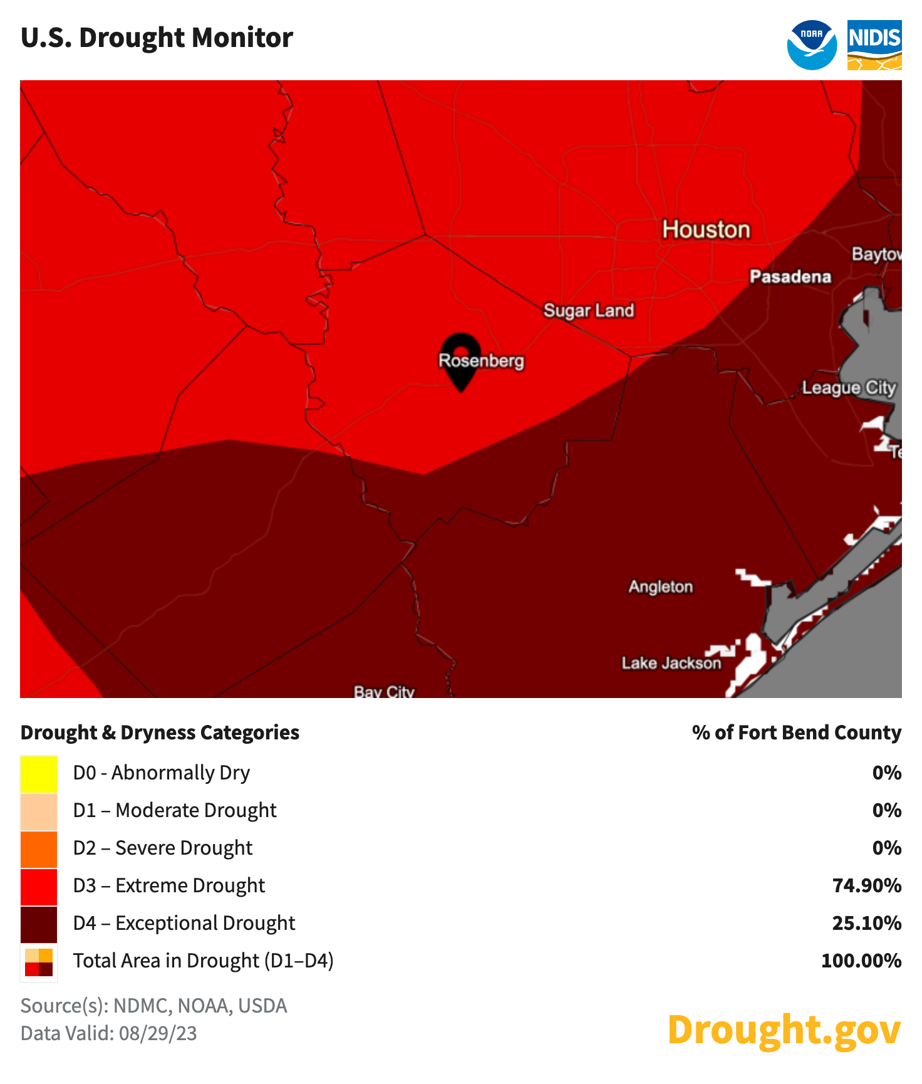
Current Conditions
Drought Conditions – Stage 2
Ft. Bend – Extreme Drought
74% of State in some form of Drought Condition
Rainfall in last 60 days: 0.38 inches
Nearby Communities in Drought Contingency:
Sugarland – Stage 1 (Surface/Ground Water)
Rosenberg – Stage 1 (Surface/Ground Water)
Brookshire – Stage 2 (Mandatory)
City of Houston – Stage 2 (Mandatory)
Jordan Ranch – Stage 2 (Mandatory)
Katy – Stage 3 (Mandatory)

Slide 13
Water System Pressures
Summer 2023 Ranges:
Plant
PSI: 44 – 58 PSI
Distribution System
PSI: 20 - 50 PSI
Per Chapter 290: Rule 290.44: A system reading is designed to be a minimum pressure of 35 PSI at all points within the distribution network (waterlines and fire hydrants); Fire fighting capability is designed to be maintained at a minimum of 20 PSI under combined fire flow and drinking water flow.

Slide 14
Investigation - TCEQ
Nine locations sampled
One location returned below required pressure
Exit Interview received August 30
Findings: AV (Alleged Violation) – 35 PSI minimum; Noted on FM 359 System north of Rogers Road
Opportunity to Respond:
Planned Improvements
Target PSI readings FM 359 N to improve PSI readings
Drought Contingency Plan Update

Slide 15
What we found:
Fluctuations in pressures within the system distribution; early morning hours between 4 a.m. – 8 a.m.
Valve survey – A number of closed or partially closed valves in Downtown System
High water users – some residential customers in upwards of 40,000 gallons per month; large commercial users are HOAs, schools, large landscape establishment projects and new developments. (Average Residential Monthly Water Usage: 12,000)
Water line breaks: dry soil can lead to service line breaks and water leaks; large service line break on customer side at FM 359 near Rogers Road
Downtown WP #1 and CCR WP #2 – out of service for plant repairs
Downtown and CCR water plants – Power concerns

Slide 16
Downtown Water System Timeline of Events – 8/20, 08/21, 08/22
9:30 p.m.
Well #3 first alert
11 p.m.
Electrician called
4:30 a.m.
Electrician left site
5:27 a.m.
Low system pressure alert (35 psi)
5:37 a.m.
Water plant pressure falls to 1.55 psi
6:42 a.m.
Boil Water Notice issued
7:03 a.m.
Generator started manually
7:17 a.m.
Well #3 started on generated power
12:39 p.m.
All systems normal/running on generator
08/22
1:25 p.m. Boil Water Notice rescinded
08/27 – 08/28
CenterPoint completed work at facility. Power transferred to normal power.
8:44 a.m.
38 psi reading at water plant

Slide 17
Boil Water Notice

Slide 18
How We’re Addressing the Findings:
Adjusting plant operations when necessary
Monitoring PSI daily
Strategic meetings with CenterPoint: improvements to Downton power supply on 8/27/2023; Site meeting at CCR Water Plant #2; replaced soft start; expressed concerns with power; monitoring for possible future adjustments
Availability of spare motors/soft starts
Analyzing alternative delivery method (modeling water system to see where this can be done)
Notifications to high water users
Closely monitoring demand on capacity – changes in Drought contingency stages possible
Inframark – staffing update
Utilizing interconnects

Slide 19
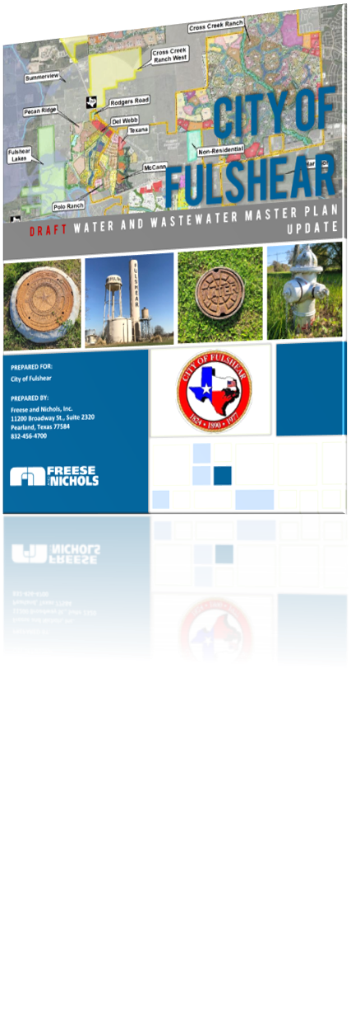
Planned Water System Improvements
New Elevated Storage Tank (1 MG): West side of FM 359 near Rogers Rd.
Out for bid for construction; in service by 1Q 2025
Fulshear Water Plant #2 - 4 MGD plant on west side of FM 359 near Rogers Rd.
Advertising for bid in September 2023; in service by 3Q 2025
Fulshear Water Plant #1 Upgrades: Ground Storage Tank (1 MG), Booster Pump (3 MGD), 16” Water Line along Leyendecker Rd
Out for bid for construction; in service by 1Q 2025
16” Water Line on Katy Fulshear and Huggins from Leyendecker Rd to FM 1093
Design NTP in October 2023; Finish design in March 2024, in service by 4Q 2024
New Water Plant at Tamarron West;
Under construction ; in service by 1Q 2024
Interconnects:
Cross Creek (2) – Fulshear Bend at Katy Fulshear & FM 1093 at Argonne Dr.
Tamarron – (1) – Water Plant No 2 in CCR
Cross Creek West (2) – FM 359 north: 1 constructed & ILA in process; 1 future
Drought Contingency Plan to be updated in FY 24
Proactive valve maintenance
Continual collaboration with CenterPoint

Slide 20
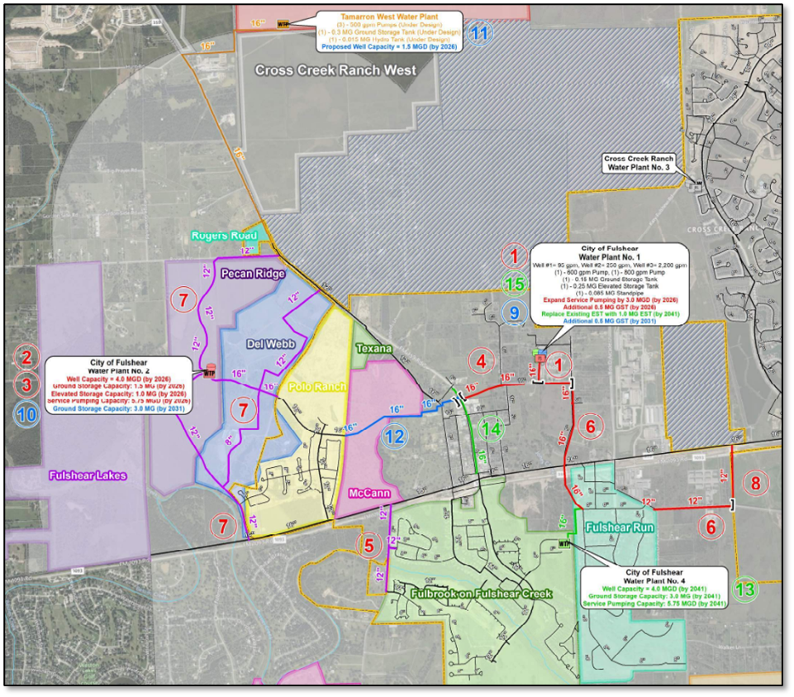
Map of Planned Water System Improvements

Slide 21
Questions
?
*Disclaimer: All facts and data included in this presentation are derived from the most accurate sources reasonably available at the time of publication, are subject to correction or verification, are for informational purposes only, and should not be relied upon for accuracy or completeness for any other purpose.

